Slide 1
Deploying a domain controller

Slide 2
Agenda
Installing a domain controller from Server Manager
Installing a domain controller on a Server Core installation of Windows Server 2016
Upgrading a domain controller
Installing a domain controller by installing from media
Cloning domain controllers
Best practices for domain controller virtualization

Slide 3
Agenda
Installing a domain controller from Server Manager
Installing a domain controller on a Server Core installation of Windows Server 2016
Upgrading a domain controller
Installing a domain controller by installing from media
Cloning domain controllers
Best practices for domain controller virtualization

Slide 4
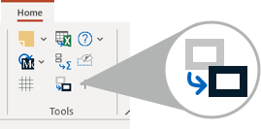
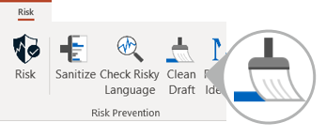

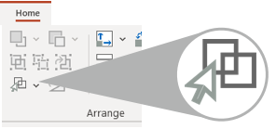

1
FORMAT UPDATER
2
CLEAN DRAFT
Spend less of your day in PowerPoint with these time-saving tips
When pasting a slide
When it’s time to clean up your pages
Clean up formatting and make content fit in one click with the Format Updater
Save time with the automatic Clean Draft tool
3
SELECT SIMILAR
See over two dozen more time-saving tips on the PowerPoint pages of the GHD website
When formatting similar objects
Click on one and use Select Similar to select the rest at once

Slide 5
Agenda
Installing a domain controller from Server Manager
Installing a domain controller on a Server Core installation of Windows Server 2016
Upgrading a domain controller
Installing a domain controller by installing from media
Cloning domain controllers
Best practices for domain controller virtualization

Slide 6
Agenda
Installing a domain controller from Server Manager
Installing a domain controller on a Server Core installation of Windows Server 2016
Upgrading a domain controller
Installing a domain controller by installing from media
Cloning domain controllers
Best practices for domain controller virtualization

Slide 7
Agenda
Installing a domain controller from Server Manager
Installing a domain controller on a Server Core installation of Windows Server 2016
Upgrading a domain controller
Installing a domain controller by installing from media
Cloning domain controllers
Best practices for domain controller virtualization

Slide 8
Agenda
Installing a domain controller from Server Manager
Installing a domain controller on a Server Core installation of Windows Server 2016
Upgrading a domain controller
Installing a domain controller by installing from media
Cloning domain controllers
Best practices for domain controller virtualization

